Slide 1
Chapter 18
Large scale machine learning
Learning with large datasets
Learning algorithms works so much better now than even say, 5 years ago, is just the sheer amount of data that we have now and that we can train our algorithms on.

Slide 2
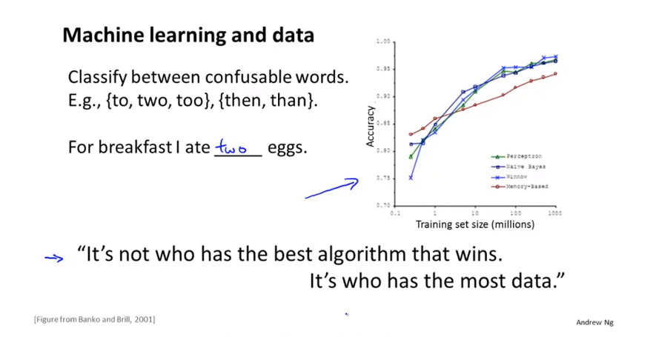
Chapter 18

Slide 3
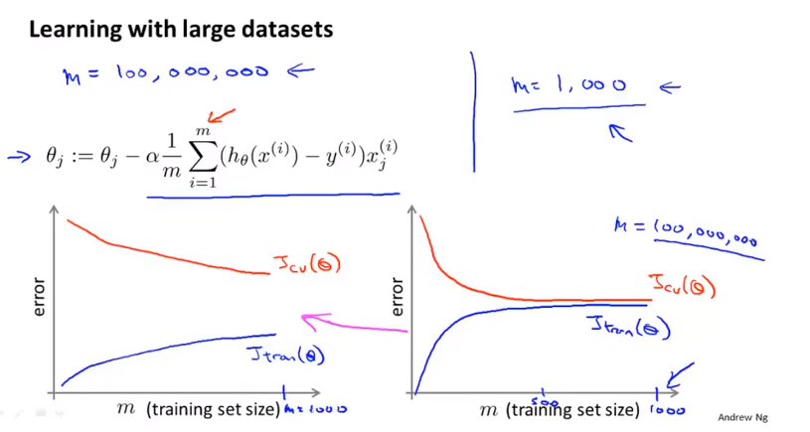
Chapter 18
For the right figure, then one natural thing to do would be to add extra features, or add extra hidden units to your neural network and so on so that you end up with a situation closer to that on the left, where maybe this is up to m equals 1000, and this then gives you more confidence that trying to add infrastructure to change the algorithm to use much more than a thousand examples, that might actually be a good use of your time.

Slide 4
Chapter 18
So in large scale machine learning, we like to come up with computationally reasonable ways, or computationally efficient ways to deal with big data sets.

Slide 5
Chapter 18
Large scale machine learning
Stochastic gradient descent
For many learning algorithm, among them linear regression logistic regression and neural networks, the way we derive the algorithm was by coming up with a cost function or coming up with an optimization objective. And using the algorithm like gradient descent to minimize that cost function. When have a very large training set, gradient descent becomes a computationally very expensive procedure. In this video, we’ll talk about a modification to the basic gradient algorithm called Stochastic gradient descent which will allow us to scale these algorithms to much bigger training sets.

Slide 6
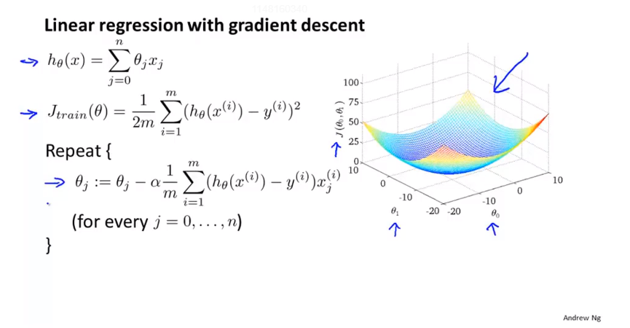
Chapter 18

Slide 7
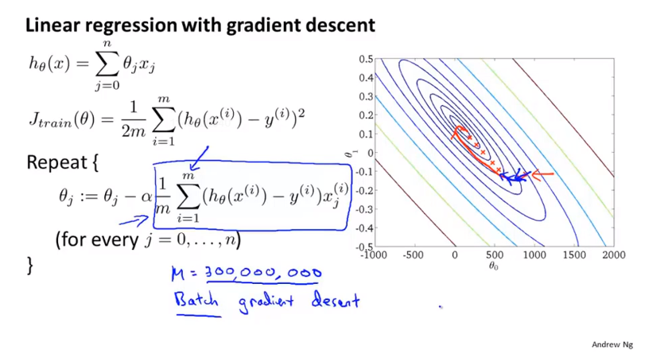
Chapter 18
Batch gradient descent: look at all the training example in every single iteration

Slide 8
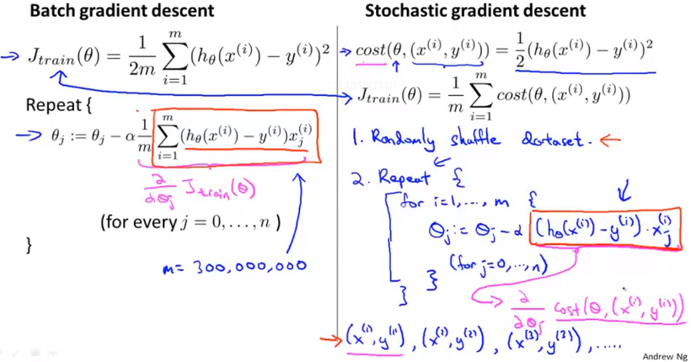
Chapter 18
Instead of scanning through all of the training examples before we can modify the parameters a little bit and make progress towards a global minimum. For stochastic gradient descent instead we just need to look at a single training example and we’re already starting to make progress in this case of parameters towards moving the parameters towards the global minimum.

Slide 9
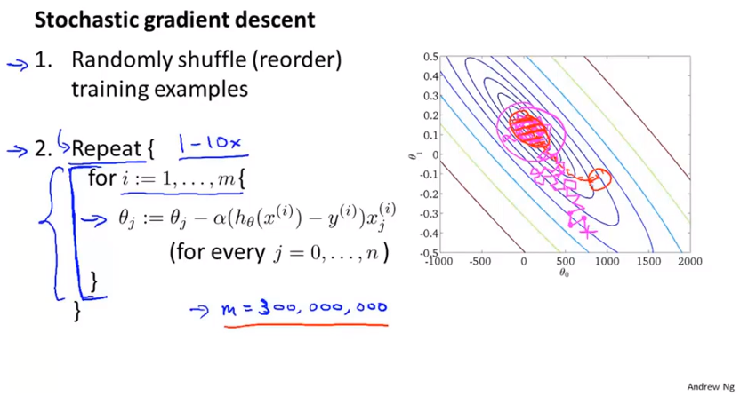
Chapter 18
And in fact as you run stochastic gradient descent, it doesn’t actually converge in the same sense as Batch gradient does and what it ends up doing is wandering around continuously in some region, close to the global minimum but it doesn’t just get to the global minimum and stay there.
But in practice this isn’t a problem because, so long as the parameters end up in some region there maybe it is pretty close to the global minimum. So as parameters end up pretty close to global minimum that will be a pretty good hypothesis and so, usually running stochastic gradient descent, we get a parameter near the global minimum and that’s good enough for essentially any most practical purposes.

Slide 10
Chapter 18
And up to, you know, maybe 10 times maybe typical so we may end up repeating this inner loop anywhere from once to ten times. So if we have a truly massive data set like the US census gave us that example with 300 million examples, it’s possible that by the time you’ve taken just a single pass through your training set. So, this is for i equals 1 through 300 million. It’s possible that by the time you’ve take a single pass through data set, you might already have a perfectly good hypothesis. In which case, this inner loop you might need to do only once if m is very, very large.
Loop takes 1 to 10 is very common, which depends on your dataset.

Slide 11
Chapter 18
Large scale machine learning
Mini-batch gradient descent
Sometimes run even faster than stochastic gradient descent.

Slide 12
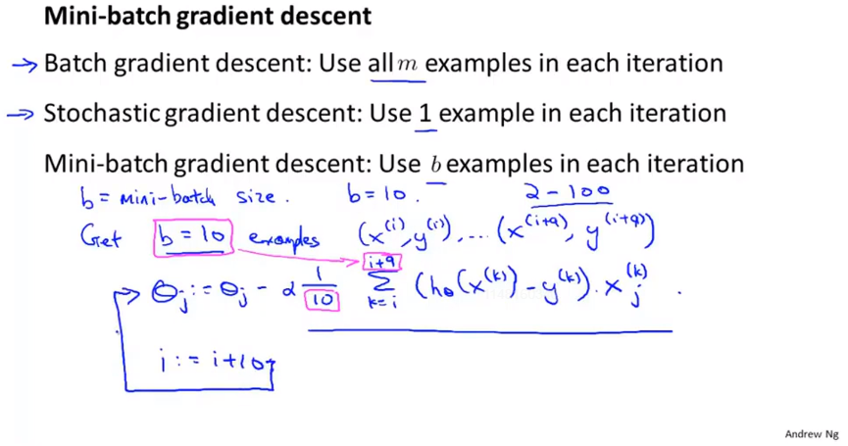
Chapter 18
Common use:
b take a value from 2 to 100, usually 10.

Slide 13
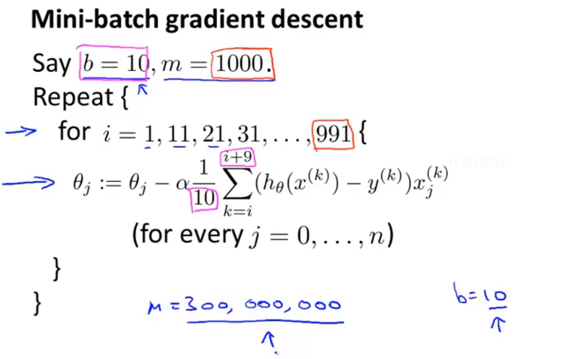
Chapter 18
Vs. Batch gradient descent
So we do not need to scan through the entire training set. We just need to look at the first 10 examples, and this will start letting us make progress and then we can look at the second 10 examples and modify the parameters a little bit again and so on.
Namely, you can start making progress in modifying the parameters after looking at just ten examples rather than needing to wait till you’ve scan through every training example of 300 million of them

Slide 14
Chapter 18
Vs. stochastic gradient descent
Vectorization
One disadvantage of Mini-batch gradient descent is that there is now this extra parameter b, the Mini-batch size which you may have to fiddle with and which may therefore take time. But if you a good Vectorized implementation, this can sometimes run even faster than stochastic grad desc.

Slide 15
Chapter 18
Large scale machine learning
Stochastic gradient descent convergence
When you running the algorithm, how do you make sure that it’s completely debugged and is converging okay. And equally important, how do you tune the learning rate alpha with stochastic gradient descent.
In this video, we’ll talk about some techniques for doing this things, for making sure it’s converging and for picking the learning rate alpha.

Slide 16
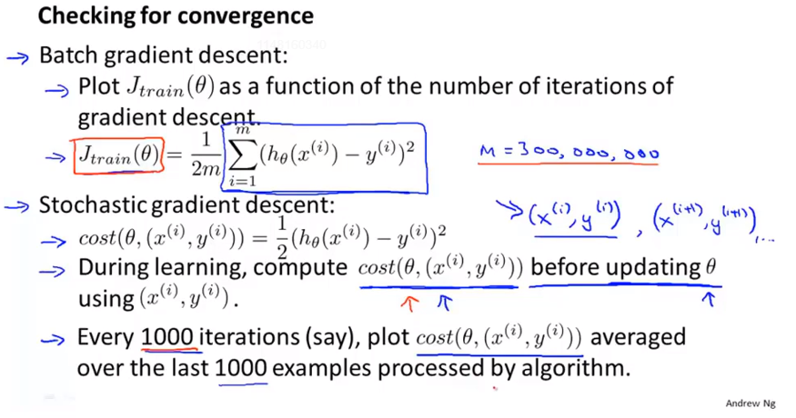
Chapter 18

Slide 17
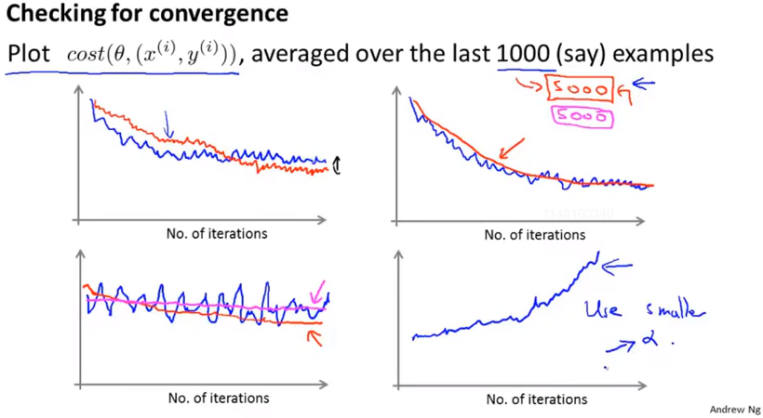
Chapter 18
By using a smaller learning rate, you’ll end up with smaller oscillations. And sometimes this little difference will be negligible, and sometimes with a smaller learning rate you can get a slightly better value for the parameters.
And if you see the errors are actually increasing, the costs are actually increasing, try using a smaller value of alpha.

Slide 18
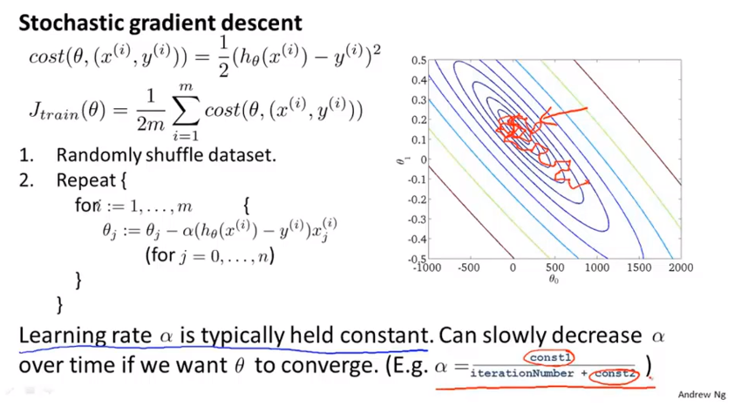
Chapter 18

Slide 19
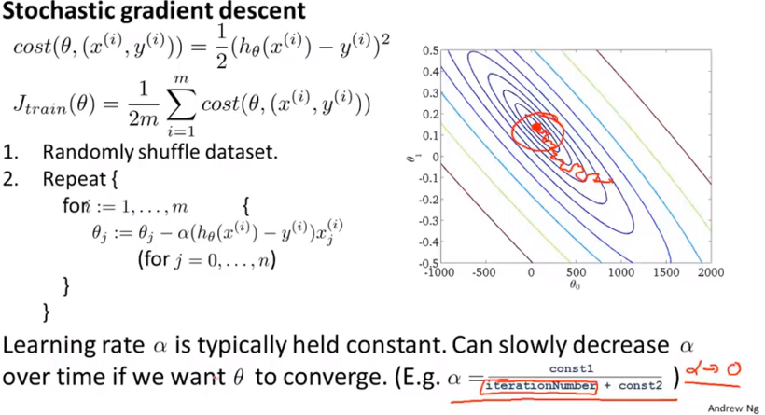
Chapter 18
So if you do slowly decrease alpha to zero, you can end up with a slightly better hypothesis. But because of the extra work needed to fiddle with the constants and because frankly usually we’re pretty happy with any parameter value that is, very pretty close to the global minimum. Typically this process of decreasing alpha slowly is usually not done and keeping the learning rate alpha constant is the more common application of stochastic gradient descent.

Slide 20
Chapter 18
Large scale machine learning
Online learning
The online learning setting, allows us to model problems where we have a continuous flood or a continuous stream of data coming in, and we would like an algorithm to learn from that.
Specifically, if you have a continuous stream of data generated by a continuous stream of users coming to your website, what you can do is sometimes use an online learning algorithm to learn user preferences form the stream of data and use that to optimize some of the decisions on your website.

Slide 21
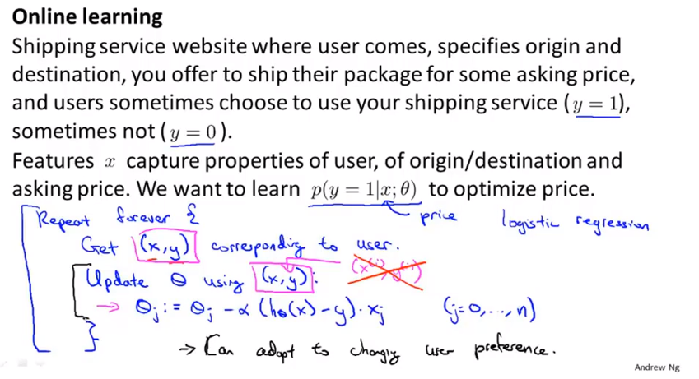
Chapter 18
If your pool of users changes, then these updates to your parameter theta will just slowly adapt your parameters to whatever your latest pool of users looks like.

Slide 22
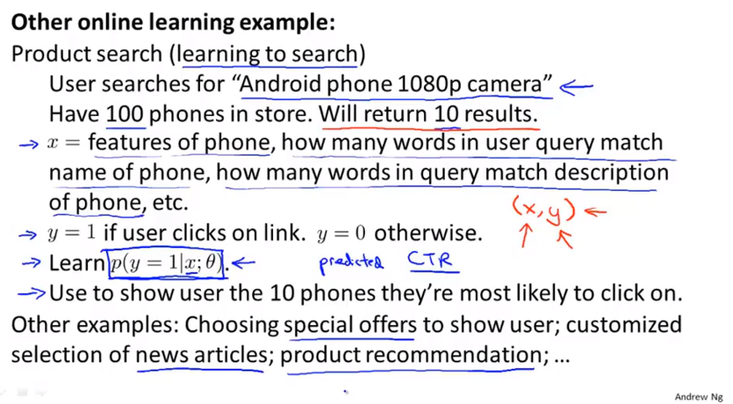
Chapter 18
If you have a collaborative filtering system, you can even image a collaborative filtering system giving you additional features to feed into a logistic regression classifier to try to predict the click through rate for different products that you might recommend to a user.

Slide 23
Chapter 18
But these are the actually sorts of problems, where you do see large companies get so much data, that there’s really maybe no need to save away a fixed training set , but instead you can use an online learning algorithm to just learn continuously form the data that users are generating on your website.
If you have a continuous stream for some application, this sort of algorithm may be well worth considering for your application. And of course, one advantage of online learning is also that if you have a changing pool of users or if the things you’re trying to predict are slowly changing like your user taste is slowly changing, the online learning algorithm can slowly adapt your learned hypothesis to whatever the latest sets of user behaviors are like as well.

Slide 24
Chapter 18
Large scale machine learning
Map-reduce and data parallelism
Using these ideas you might be able to scale learning algorithms to even far larger problem than is possible stochastic gradient descent.

Slide 25
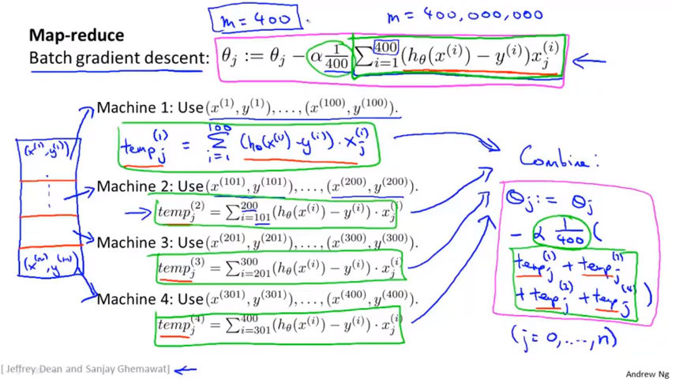
Chapter 18
Exactly equivalent to the batch gradient descent algorithm.
Only instead of needing to sum over all 400 training examples on just one machine we can instead divide up the workload on four machines.

Slide 26
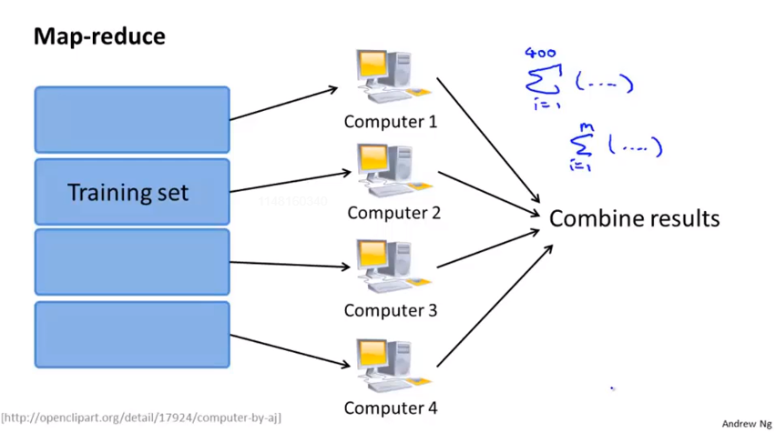
Chapter 18
In particular if there were no network latencies and no cost of the network communication to send the data back and forth you can potentially get up to a 4x speed up. And of course in practice because of network latency, is the overhead of combining the results afterwards and other factors, in practice you get a slightly less than 4x speed up. But nonetheless this sort of MapReduce approach does offer us a way to process much large data sets than is possible using a single computer.

Slide 27
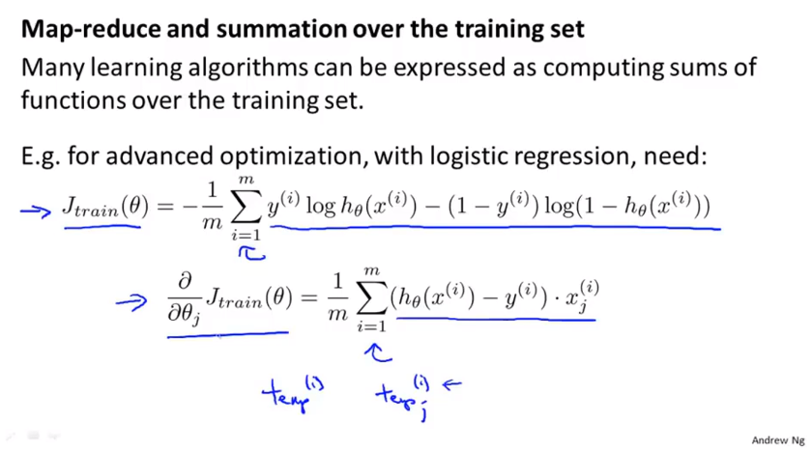
Chapter 18
Then map-reduce might be a good candidate for scaling your learning algorithm to very vary big data sets. Advanced optimization: L-BFGS, conjugate gradient and so on.
So more broadly by taking other learning algorithms and expressing in sort of summation form or by expressing them in term of computing sums of functions over the training set, you can use the MapReduce technique to parallelize other learning algorithm as well and scale them to very large training sets

Slide 28
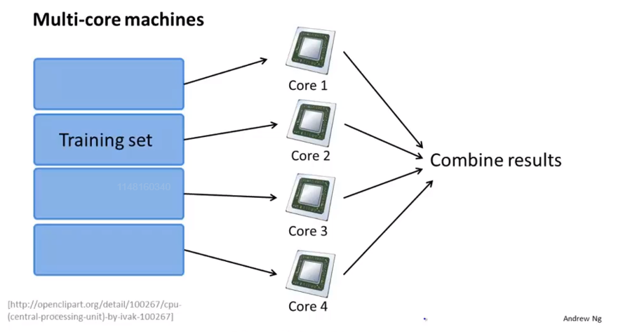
Chapter 18
If you are one of a libraries that can compute parallelizing and if you have a very good vectorized implementation of a learning algorithm sometimes you can just implement your standard learning algorithm in a vectorized fashion and not worry about parallelization and your numerical linear algebra library could take care of some of it for you. So that you don’t need to implement MapReduce.

